Slide 1
Bray Team:
Embedded Valve and Actuator Sensors
MEEN 402 Intro Presentation
Team: Avery Haynes, Locke Lehmann, Travis Carlson, Cody Sims, Zachary Walker, Michael Hager
1/22/2024
Notes:
Cody

Slide 2
Introduction
Bray is a premier manufacturer of flow control and automation products and accessories.
Assigned to work with Bray to:
Develop a method to internally measure valve position independent of an actuator
Measure actuator output torque to increase the valve's service life
Current Industry solution: IOT Torque Bracket
Indirect measurement of actuator torque
Does not provide ‘full picture’ on if the valve or actuator is failing.
Notes:
Cody

Slide 3
Problem
Develop a method to internally measure valve position independent of an actuator and measure actuator output torque to increase the service life of the valve.
Opportunity to incorporate 3D metal printing?
Notes:
Cody

Slide 4
Project Motivation
More accurate valve and actuator monitoring
Planned preventative maintenance and live adjustments
Proactive rather than reactive maintenance
Catching problems before they occur
Less part damage > longer life
Less downtime > more working time
Notes:
Cody

Slide 5
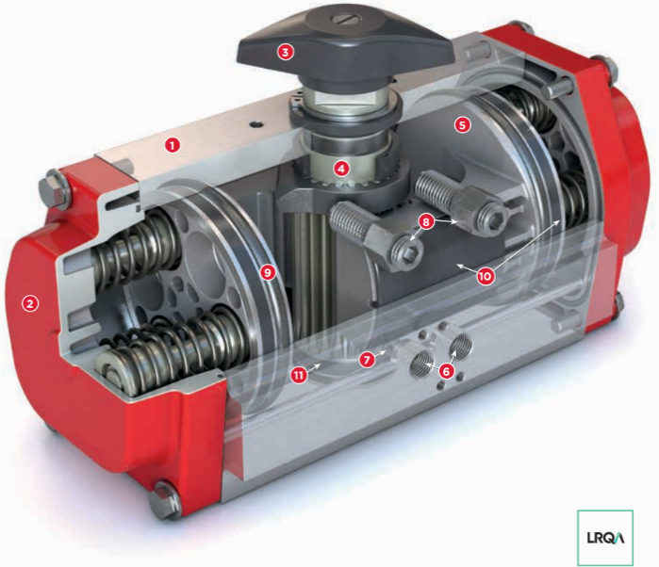
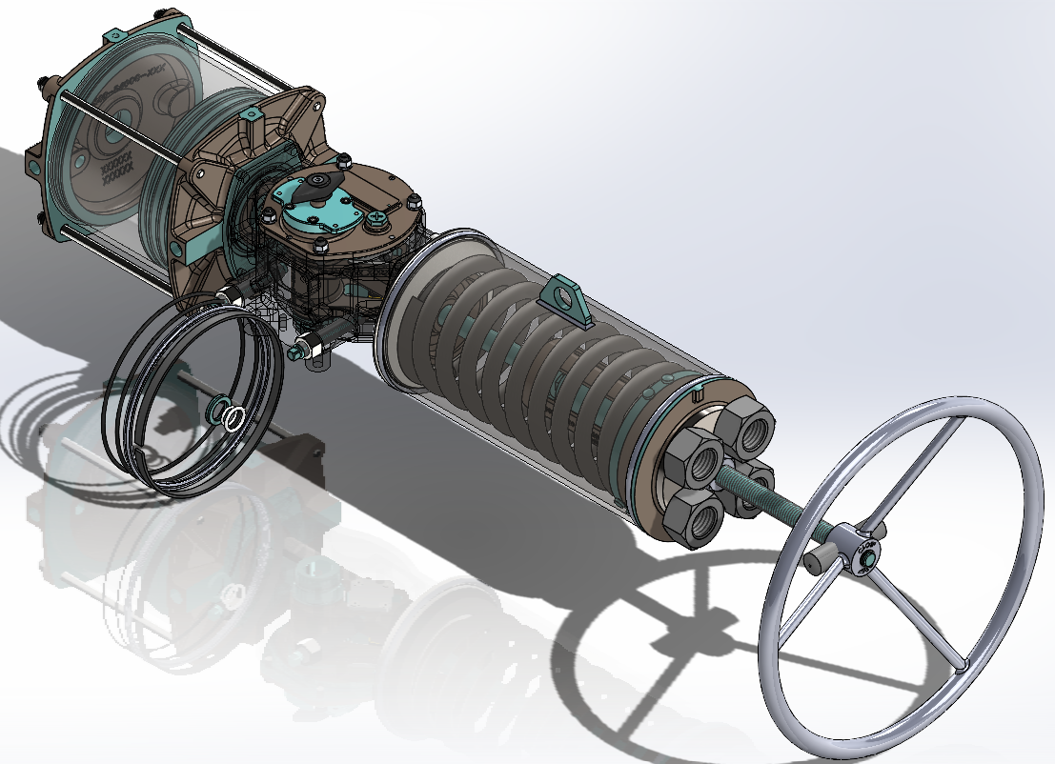
Relevant Products
S92 rack-and-pinion actuator S98 scotch-yoke actuator
Both are not yet “smart”
Notes:
Travis

Slide 6
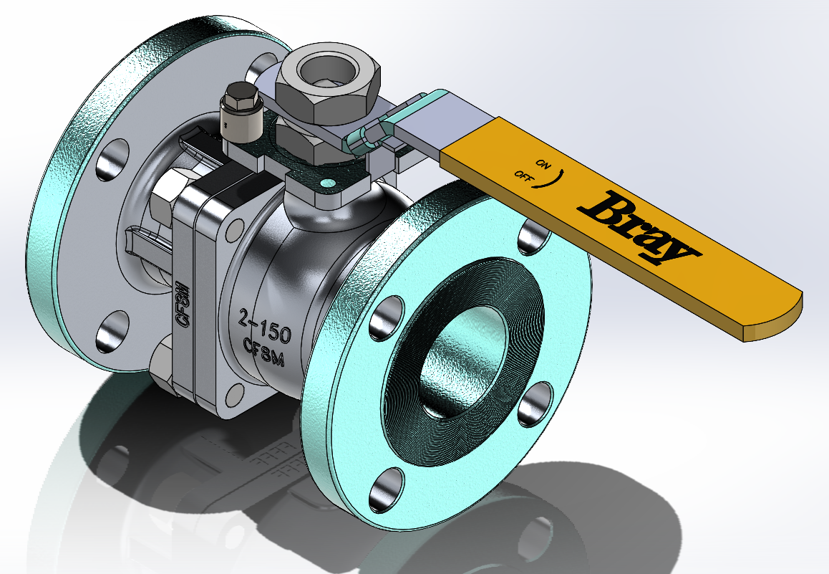
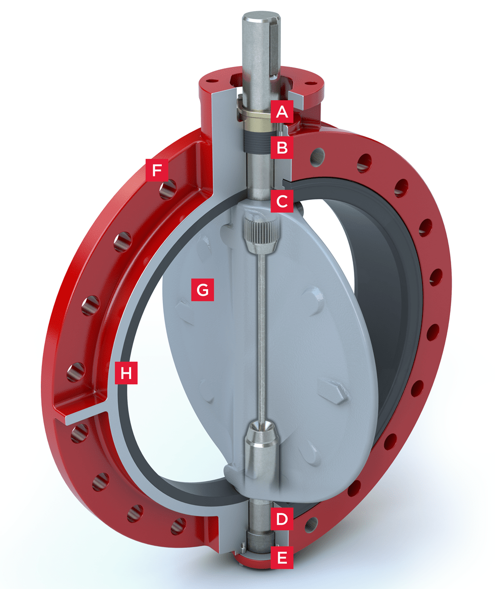
Relevant Products
Butterfly and ball valves
Focusing on ball valve due to higher engineering complexity.
Project solution should be agnostic to valve type.
Notes:
Travis

Slide 7
Customer Needs
# | Need | Importance
1 | Final product is embedded into the actuator casing | 1
2 | Product is scalable for different-sized valves | 2
3 | Product records and transmits sensor data | 1
4 | Works in a wide temperature range (-40℉-300℉) | 4
5 | Works under various pressures (100 psi - 740 psi) | 3
6 | Works for various fluid mediums | 4
7 | Measures actuator torque to < 5% error | 1
8 | Relatively short lead times for parts (3-4 weeks) | 2
9 | Determines true valve position independent of actuator | 1
10 | Works for both pneumatic and hydraulic actuators | 3
11 | Short time for calibrating the sensor | 3
Notes:
Travis

Slide 8
Design Requirements
Req,t # | Need # | Metric | Imp | Required Values | Units
1 | 7, 9, 10 | Measurement Accuracy | 5 | < 5 | %
2 | 1, 2, 4, 5, 6 | Location of sensors | 4 | Valve casing, Stem, Actuator casing | N/A
3 | 3 | Lifetime of sensors | 3 | > 20 | years
4 | 8 | Ease of maintenance | 2 | < 4 | # parts
5 | 2, 11 | Ease of implementation | 3 | < 2 | hours
6 | 11 | Calibration Time | 3 | < 2 | hours
7 | 1, 2 | Volume of apparatus | 1 | < 5 | in2
8 | 3 | Power consumption | 1 | < 100 | Watt hours
Notes:
Zack

Slide 9
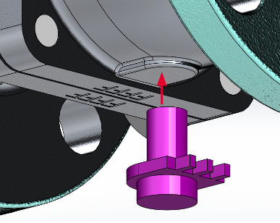
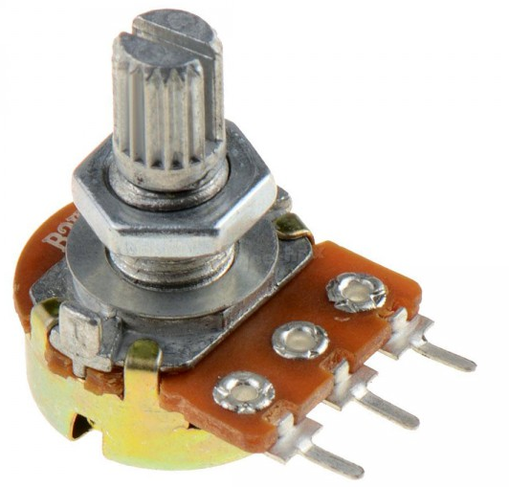
Design Concepts (Position)
Rotary Potentiometer
Stem of potentiometer is connected to base of the ball valve
As the ball rotates, so does the potentiometer
Adhering to code/standards is a challenge for this concept
Notes:
Zack

Slide 10
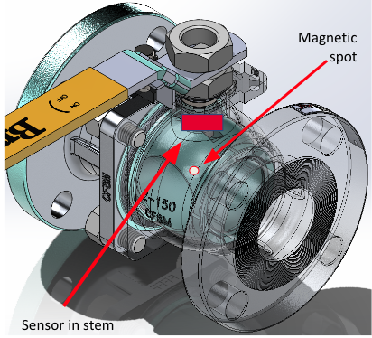
Design Concepts (Position)
Hall Effect Sensor
Sensor tracks field from magnetized point on ball
Will require calibration of “standard” magnetic fields at open/close
Must determine relationship between field readings and position
Embedded in casing or stem
Notes:
Zack

Slide 11
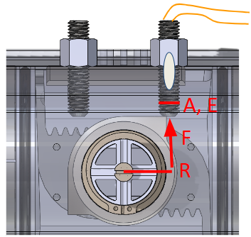
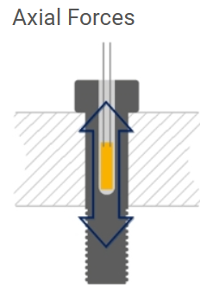
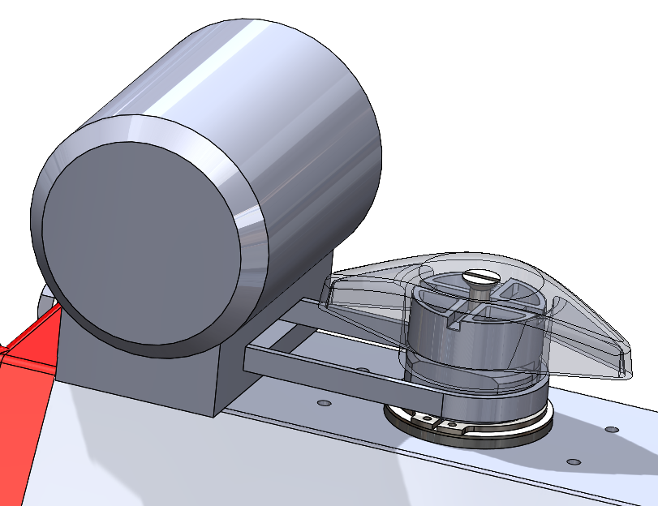
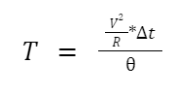
Design Concepts (Torque)
Cylindrical Strain Gauge
Motor EMF
Embedded in the stop bolts of the actuator.
Measure force required to stop the opening or closing stroke.
Convert the force reading to torque since we know the measurements of the stop bolts.
Belt moves with the switch generating voltage in the motor.
Using Torque equation above measuring time of activation and knowing a valve turns 90° average torque can be found.
Notes:
Zack

Slide 12
402 Objectives - Position
Functional Requirement | Quantitative Requirement | Design feature | Validation Test | Actual Value | Satisfied
Measurement Accuracy | < 2% | Potentiometer | Measure the position slider reading of the rotary potentiometer and compare to actual rotation by hand (test how ambient temperatures affect accuracy)
Surrounding metals do not interfere with accuracy | <2 % | Hall effect sensor and magnet | Attach a magnetic point to the edge of the butterfly disc and measure change in magnetic field due to rotation
Ease of implementation | <2 hr | Prototype Apparatus | Time how long it takes to set up the sensors on the prototype valve system
Calibration Time | < 1 hr | Sensor | Time how long it takes to start getting accurate readings from the sensor system from start to finish
Measurement accuracy with extended use | < 5% | Potentiometer and Hall Effect Sensor | Measure the decay of accuracy as the potentiometer cycles till failure
Lifetime of sensor | > 2 million cycles | Potentiometer and Hall Effect Sensor | Rotating ball system that open and closes to test how many cycles until the sensor fails
Total power Consumption | <100 wh | Battery | Use prototype system and measure the amount of power consumed over an hour
Notes:
Locke

Slide 13
402 Objectives - Torque
Functional Requirement | Quantitative Requirement | Design feature | Validation Test | Actual Value | Satisfied
Measurement Accuracy | < 5% | Cylindrical Strain Gauge and Motor | Measure and compare the reading of the torque reading to the actual set value (test how ambient temperatures affect accuracy)
Ease of implementation | <2 hr | Prototype Apparatus | Time how long it takes to set up the sensors on the prototype valve system
Calibration Time | < 1 hr | Sensor | Time how long it takes the team to start getting accurate readings from the sensor system from start to finish
Measurement accuracy with extended use | < 5% | Cylindrical Strain Gauge and Motor | Measure the decay of accuracy as the rotational torque bracket or potentiometer cycles till failure
Lifetime of sensors | > 2 million cycles | Cylindrical Strain Gauge and Motor | Rotating Actuator system that open and closes to test how many cycles until the sensor fails
Total power Consumption | <100 wh | Battery | Use prototype system and measure the amount of power consumed over an hour
Notes:
Locke

Slide 14
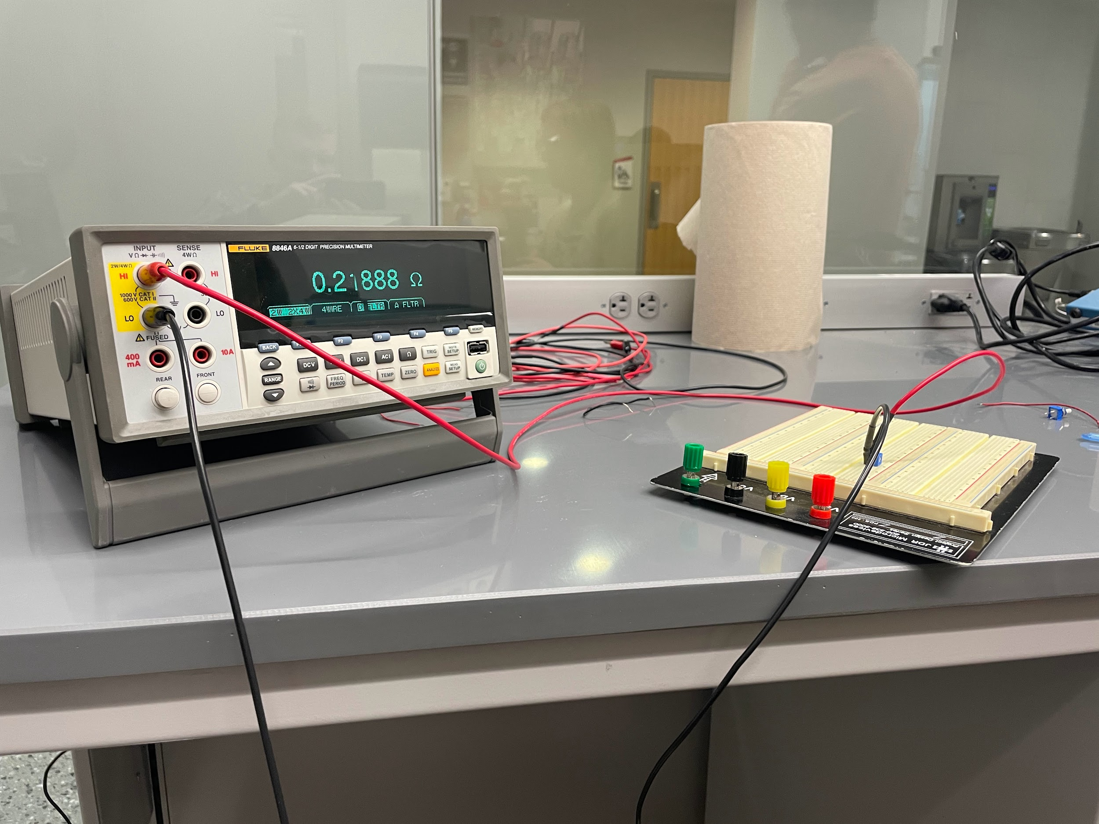
Initial Validation Testing
Position: Potentiometer
Tested to see correlation between resistance and position
Linear 10 KΩ pot met the <5% accuracy reqt.
Position (degrees) | Resistance (ohms) | Predicted Position (degrees) | error %
0 | 0.24 | -0.000024 | 0.24
270 | 94732 | 270.1 | 0.029
0 | 0.24 | -0.000024 | 0.24
270 | 94748 | 270.1 | 0.046
0 | 0.22 | -0.000081 | 0.81
270 | 94736 | 270.1 | 0.034
0 | 0.25 | 0.0000048 | 0.048
270 | 94806 | 270.3 | 0.11
0 | 0.25 | 0.0000048 | 0.048
270 | 94616 | 269.7 | 0.093
0 | 0.29 | 0.00012 | 1.2
270 | 94587 | 269.7 | 0.12
Notes:
Locke

Slide 15
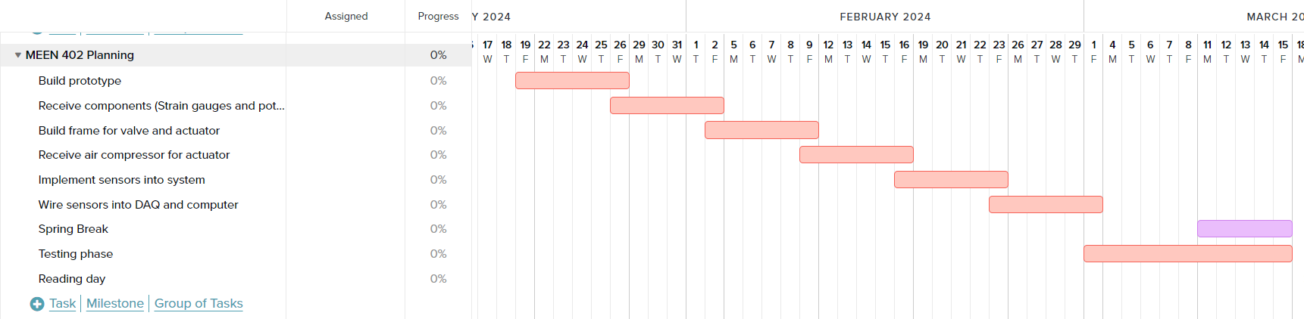
Gantt Chart
Notes:
Michael

Slide 16
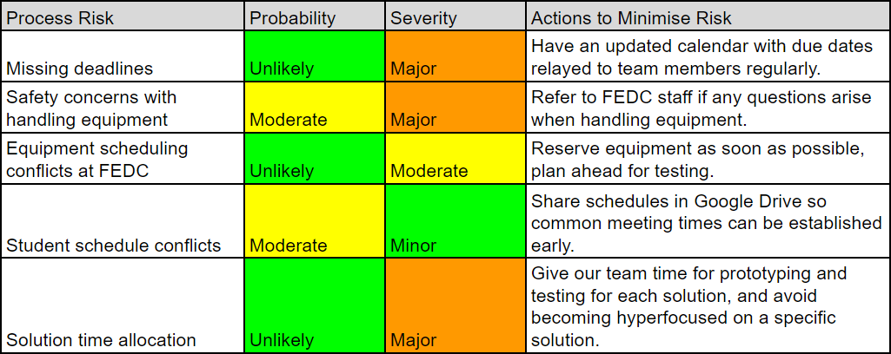
Process Risk Assessment
Notes:
Michael

Slide 17
401 Presentation Feedback
Pursue testing and data analysis with the Rotary Potentiometer and Cylindrical Strain Gauge
Backup solutions for each include Hall Effect Sensor and EMF Generation
Order parts NOW to begin testing
Reserve space in the FEDC
Only one deliverable is necessary, two is a bonus
Notes:
Michael

Slide 18
Final Deliverables
Provide a comprehensive solution for detecting valve positions and internal actuator torque
Scalable to varying actuator and valve sizes
Solution is cost-effective and safe for the user
Focus on the potentiometer and strain gauge as our solution, as well as the hall effect sensor and EMF generation
Collaborate with Bray to possibly metal-3D-print prototypes of solutions, which will undergo testing with their valves and actuators
Notes:
Avery

Slide 19
Conclusions
Concepts to measure valve position
Rotary Potentiometer, Hall Effect Sensor
Concepts to measure actuator torque
Cylindrical Strain Gauge, EMF Generation
Spring Semester Goal
Develop, test, and validate design concepts and determine which best meets project deliverables.
Needed Facility Access: FEDC (Texas A&M)
Estimated Budget: $2,955
Approved and supplied by Texas A&M
Notes:
Avery

Slide 20
Questions?
Notes:
Avery

